Slide 1
Principles of Internet censorship and solutions
Принципы интернет-цензуры и способы обхода
Чжоу Хунсян P33131
Факультет ПИиКТ
27-02-2024

Slide 2
Contents
Каталог
01
Introduction
02
Principles
Введение
Принципы
03
Solution
04
Challenge
решение
Испытание

Slide 3
1. Social Background
Part 01
2. Freedom and Limit
Introduction
3. Inconvenience

Slide 4
01
Social Background
Internet Technology
Freedom
Social Problems
We are living in a society with highly developed Internet technology
We can obtain, publish and spread different kinds of information between races, regions and countries
Rumors,
Cyberbullying,
Pornography,
Racism
etc.

Slide 5
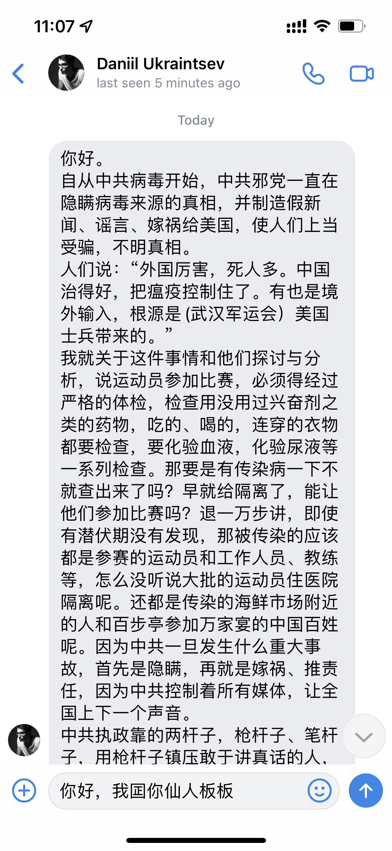


01
Social Background
The Nth Room Case
About 260,000 people participated in sex crimes to 76 women(including 16 underage girls), on Telegram.
Personal experience
there has been such a group on the Internet spreading all kinds of fabricated rumors and try to divide our government and our nation.

Slide 6
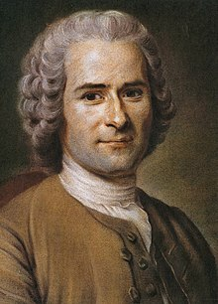
01
Freedom and Limit
“Everyone is born to be free,
but everywhere he is in chains.”
By Jean-Jacques Rousseau

Slide 7
01
Inconvenience
Increased the difficulty in obtaining information
Influenced the spread of information and knowledge
Limited the use of internet service
And so on
……

Slide 8
1. Web Browsing
2. URL Filtering
Part 02
3. DNS Hijacking
Principle
4. IP Blocking
5. Keyword Filtering
6. DPI

Slide 9
02
Web Browsing
What exactly happens after we enter a URL into our Web Browser?

Slide 10
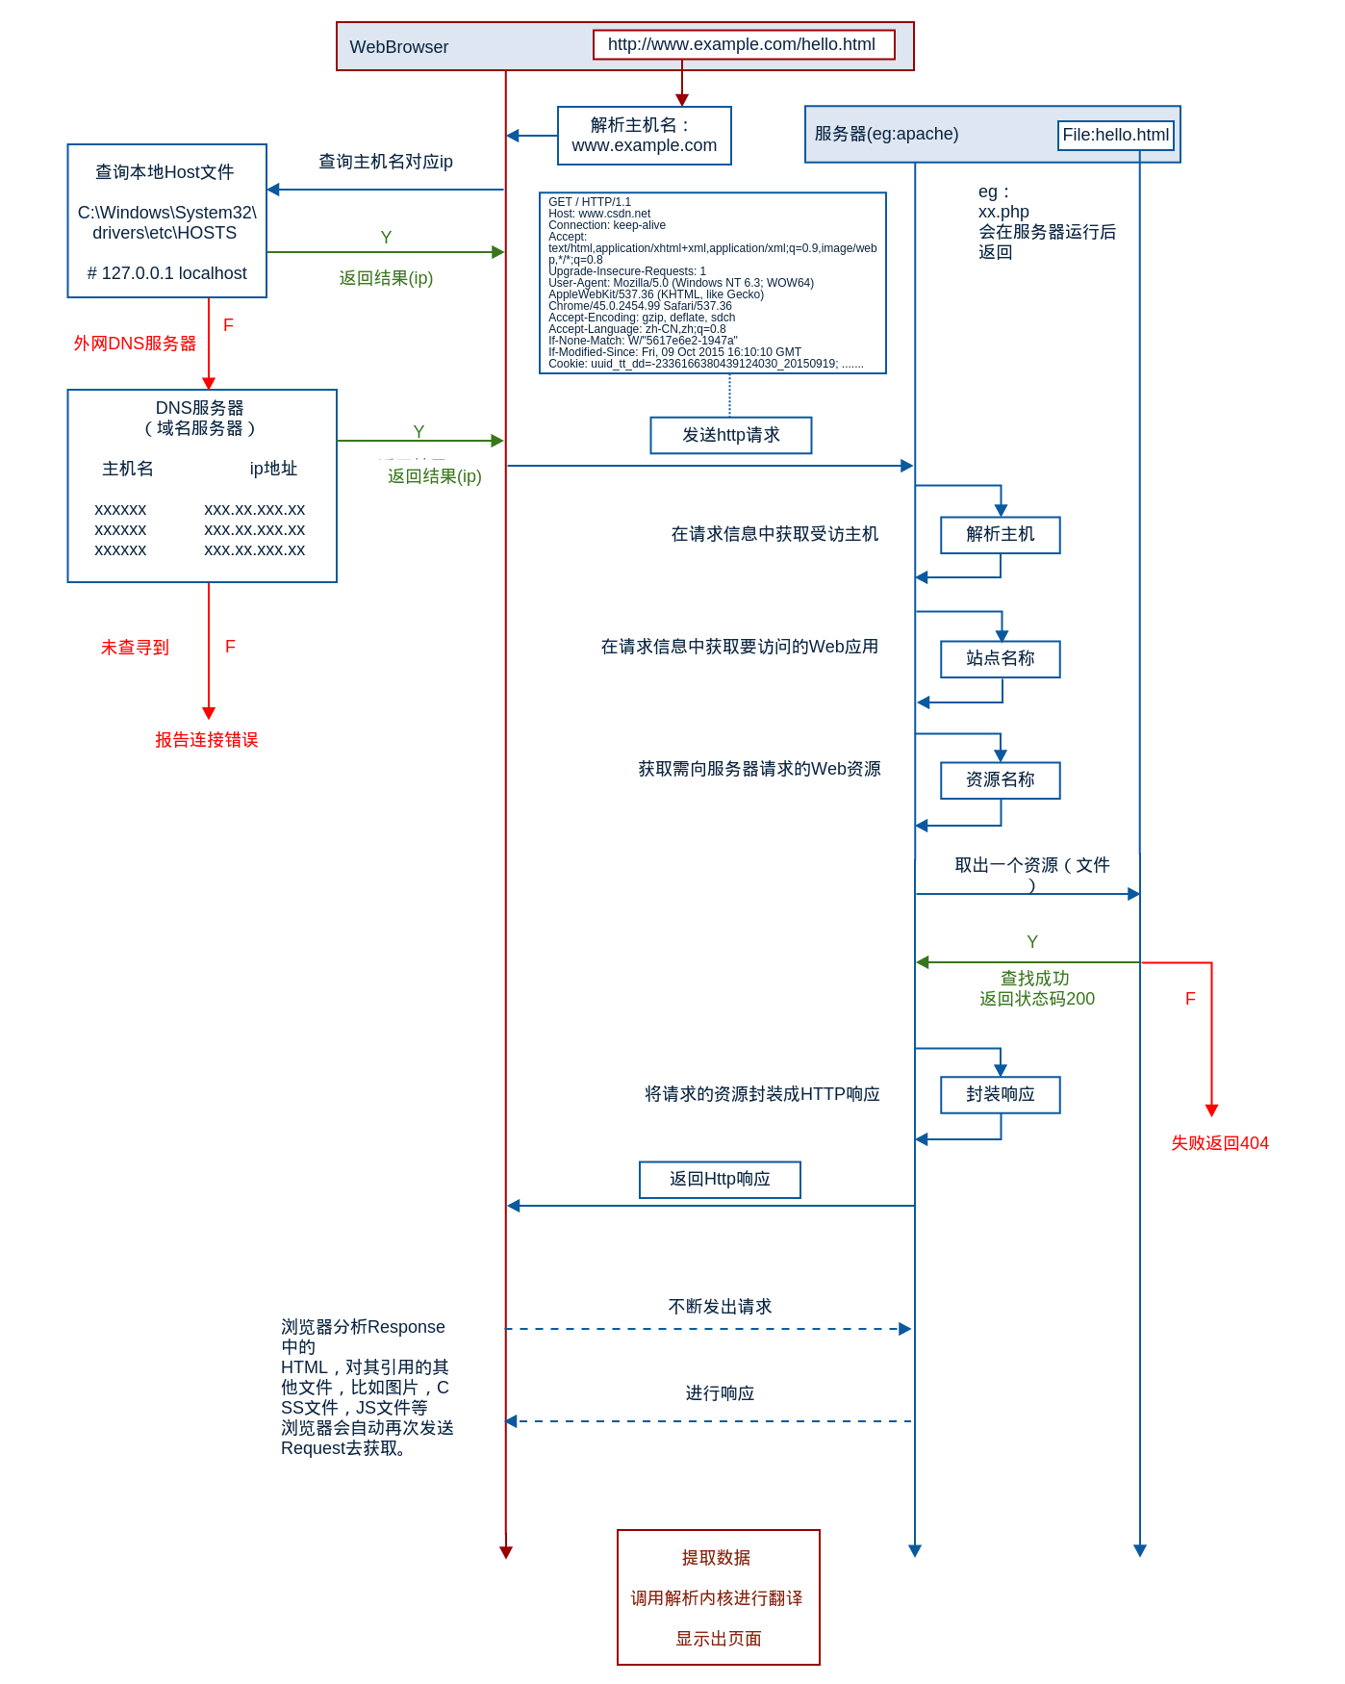
resolve domain name
02
Find the correct IP of host
server
Web Browsing
Search local host file
will be returned after the server is running
Return result (IP)
Outer Domain server
DNS server
(Domain server)
Send http request
Host name
IP address
Return result (IP)
Get the visited host in the request information
Resolve host
1. Input URL
2. Resolve DNS
Not found
Obtain the web application to be accessed in the request information
Name of site
Report link error
Get the web resource requested from the server
Name of resource
3. Build TCP link
4. Send http request
Get the resource file
find success
5. Handle request
6. Send http response
Return code 200
Encapsulate the requested resource into an HTTP response
Encapsulated response
Fail return 404
return http response
7. Render page
8. Show page
The browser analyzes the HTML in the response and the other files referenced by it (images, CSS files, JS files, etc.), and the browser will automatically send the Request again to obtain them.
Keep sending request
Keep responding
Extract data
Call the browser kernel for translation
Render page

Slide 11
02
Web Browsing
How can wen block a user from accessing web pages normally?

Slide 12
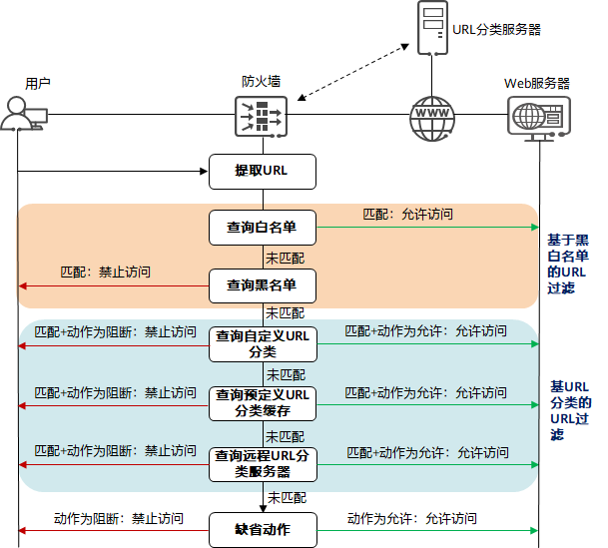
02
URL Filtering
URL filtering server
Get URL
User
Fire Wall
Web server
Get URL
Compare info
Search white list
Match: Allow access
URL filtering based on black and white list
No match
Execute action
No match: Access denied
Search black list
No match
No match + action is block:
access denied
search custom URL classification
Match + action allow: allow access
Allow/Reject
Fire Wall
No match
URL filtering based on URL classification
No match + action is block:
access denied
search predefined URL classification cache
Match + action allow: allow access
No match
Continue
Redirect to Error
No match + action is block:
access denied
search remote URL filtering server
Match + action allow: allow access
No match
Action is block: access denied
Default action
Action allow: allow access

Slide 13
02
URL Filtering
Local and Cloud Storage
Ways to organize URL filtering
Local URL cache: Storing frequently accessed URLs
URL Cloud: Storing more URLs
URL classification
Single URL blacklist
Single URL whitelist
……

Slide 14
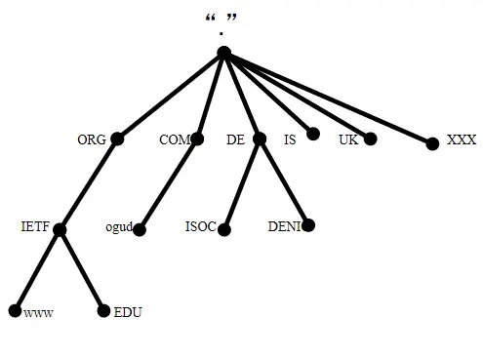
02
DNS Hijacking
Domain Name Structure
www.ogud.com
.www | .ogud | .com | .
Third domain | Second domain | Top domain | Root domain

Slide 15
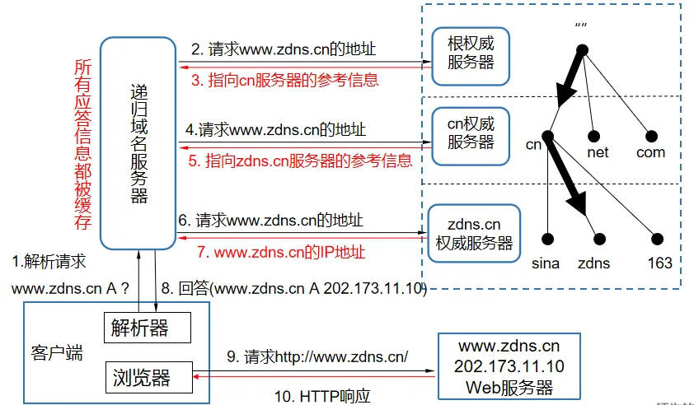
02
DNS Hijacking
DNS Resolution Process
2. Request address of
www.zdns.cn
.Root Server
3. Point to cn server
4. Request address of
www.zdns.cn
Response information for all requests will be cached
.cn Server
Domain Name Server
5. Point to zdns.cn server
6. Request address of
www.zdns.cn
.zdns.cn. Server
1. resolve request
7. Got IP address of www.zdns.cn
8. Response (www.zdns.cn A 202.173.11.10)
Resolver
Client
9. Http request
Browser
Web server
10. Http response

Slide 16
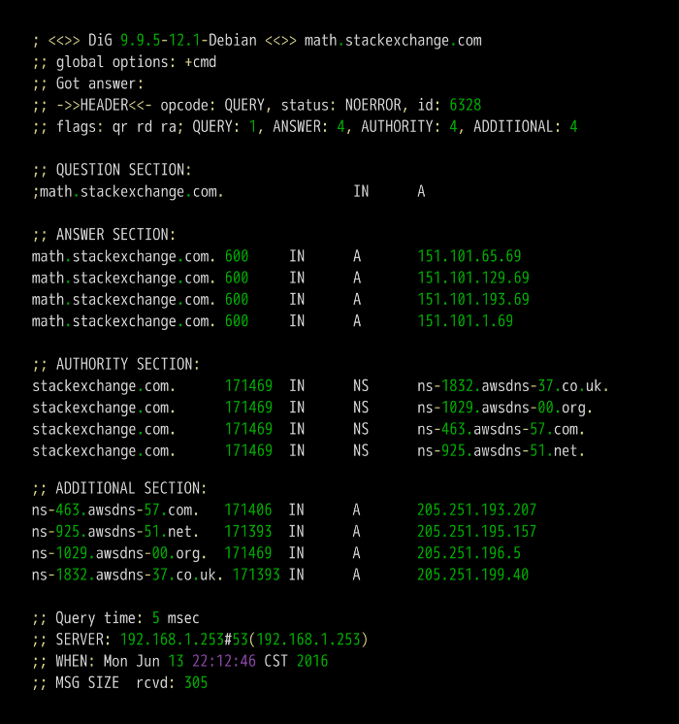
02
DNS Hijacking
$ dig math.stackexchange.com
1. query parameters and statistics
2. query content
3. DNS server's response
4. NS(Name Server) record of math.stackexchange.com
5. IP address of the above four domain name servers
6. Transmission information from the DNS server

Slide 17
02
DNS Hijacking
Modify DNS response
Modify DNS Cache
Configure DNS server
The hijacker can intercept DNS query requests during packet transmission and return modified DNS response， causing the user to access the wrong target website.
Hijackers can use the mechanism of the DNS server cache to store incorrect DNS resolution results in the DNS cache, affecting all users who initiate query requests to the DNS server.
Hijackers can change the DNS server configuration in various ways, causing users to connect to other DNS server and get incorrect resolution results.

Slide 18
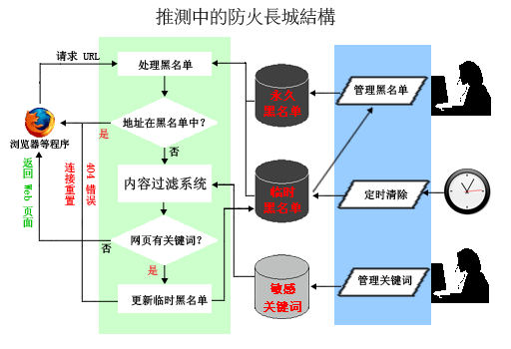
02
IP Blocking
Keyword Filtering
Example process of IP blocking and keyword filtering
IP request
Handle IP backlist
Permanent blacklist
Manage backlist
If IP is in backlist?
Yes
Web browser
No
Keyword filtering system
Temporary blacklist
Clear on time
Redirect link
Return Web page
404 error
If page has keyword?
No
Yes
sensitivekeywords
Manage keyword
Update temporary blocklist

Slide 19
02
Keyword Filtering
Router level
Web service level
Application level
keyword filtering in routers, gateways, and firewalls to identify URLs and data packets can be used to restrict external communications within the intranet.
Server-side filtering of Internet applications such as forums, online games, and news comments, often used to control speech that is pornographic, violent, religious, or other policy requirements
The network application software itself comes with a keyword list to process the specified keywords.

Slide 20
02
Keyword Filtering
Algorithm
String matching
Regular expression
Machine learning
Match every word or phrase in the text to the target keyword. A match is considered successful if the text contains the exact same word or phrase as the keyword
Use regular expressions to flexibly match patterns in text, including keywords, phrases, etc. to detect and filter keywords
Automatically learn the characteristics and contextual information of keywords based on large amounts of training data, thereby achieving more accurate and intelligent keyword filtering.

Slide 21
1. Hosts file
Part 03
2. Proxy Server
Solution
3. VPN

Slide 22
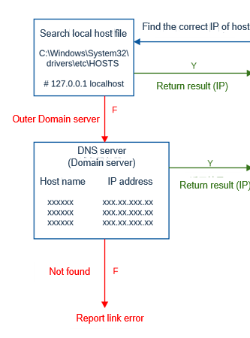
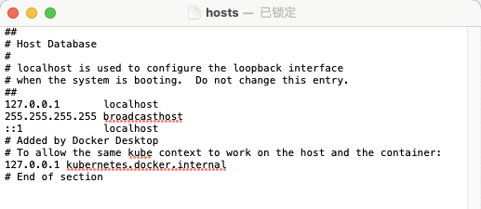
03
Hosts file
The hosts file is an operating system file without an extension.
It stores the mapping relationship between host names and IP addresses in the form of a table.
It has a higher query priority than the DNS server during the DNS resolution process.

Slide 23
03
Hosts file
Based on these characteristics, we can modify the hosts file and add the mapping relationship between domain names and IP addresses to break through network censorship based on DNS hijacking.

Slide 24
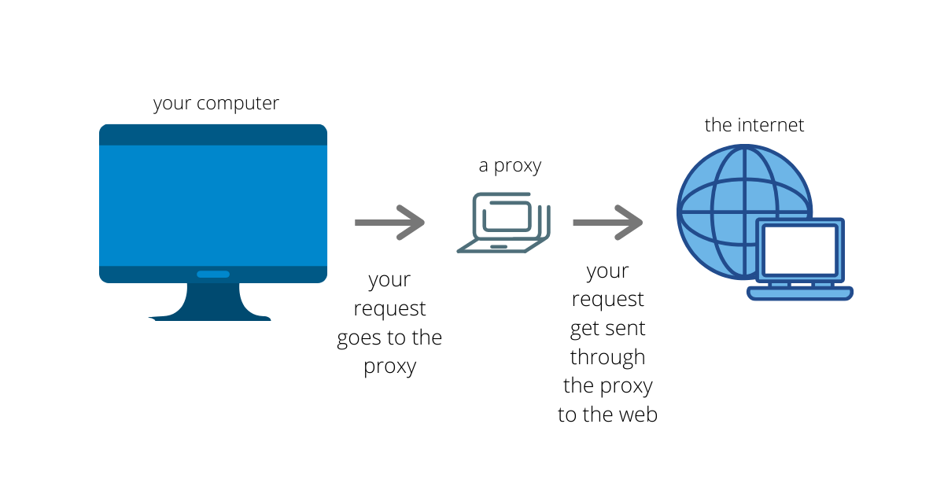
03
Proxy Server

Slide 25
03
Proxy Server
1. Receive request
2. Parse request
3. Handle request
4. Forward request
5. Receive response
6. Parse response
7. Handle response
8. Return response

Slide 26
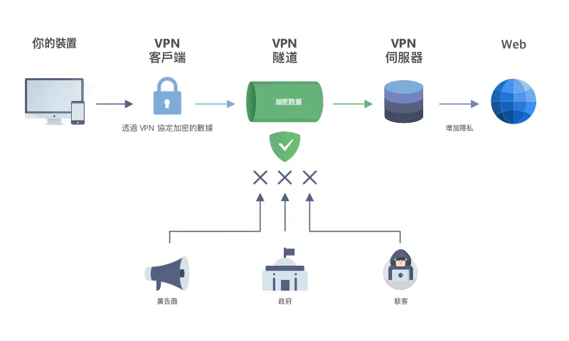
03
VPN
Your device
VPN
Client
VPN
Tunnel
VPN
Server
Encrypt data
Advertisers
Internet censorship
hacker

Slide 27
Part 04
1. Technical
Challenge
2. Social

Slide 28
04
Technical Challenge
Encryption & Privacy
Anonymization
Emerging Technology
The spread of encrypted communications and privacy protection technologies allows users to access the Internet more securely, bypassing censorship and surveillance.
The development of network anonymization tools such as Tor and VPN allows users to hide their real IP addresses and bypass geographical restrictions and censorship firewalls.
The application of emerging technologies, such as blockchain, decentralized technology, etc., may provide new means to bypass censorship and blocking.

Slide 29
04
Social Challenge
Personal Privacy
Freedom of Speech
Region Isolation
Some way of Internet censorship may involve invasion of personal privacy, such as monitoring and intercepting personal communications, collecting personal data, etc.
Internet censorship limits people’s ability to freely express their opinions and views on the Internet. This may lead to misalignment of information and affect the public's understanding and judgment of facts.
Internet censorship may lead to the isolation of cyberspace, making it hard for people in different regions to share the same information resources. This may exacerbate information gaps between regions.

Slide 30
04
Key
Balance between freedom and limitation

Slide 31
Thanks for listening
Спасибо за Внимание
Чжоу Хунсян P33131
Факультет ПИиКТ
27-02-2024

Slide 32
04
Question
What is the differences between URL Filtering and DNS Hijacking?
If we want to block a certain page like example.com/news of the website, but allow access to the other page of example.com, which way should we choose?

